Slide 1
Typing Master Using python
Ifron Biswas Registration ID: 17101043 Md Razon
Registration ID: 17101046
Notes:
1

Slide 2

What is Typing master ?
2
A Typing master is a application where you can test your typing speed and can see WPM of yours.
Notes:
2

Slide 3
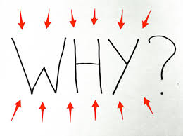
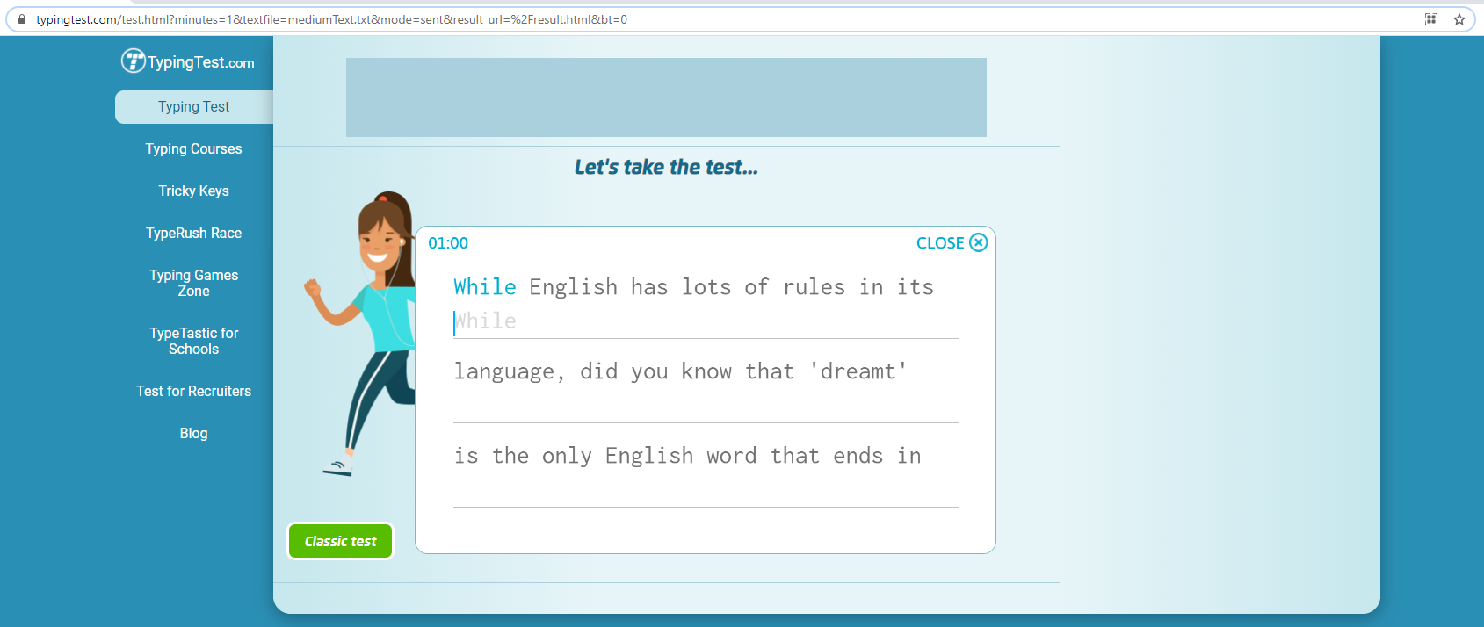
Motivation behind this
There are many available software to test WPM but a program is different So I decide to make TYPING MASTER program using PYTHON. By using pyGame library it can be possible.
Online website of type master.
Notes:
3

Slide 4
Things available in
4
Time
Words per minute typed
Accuracy percentage
Notes:
4

Slide 5

Thank You

